Slide 1
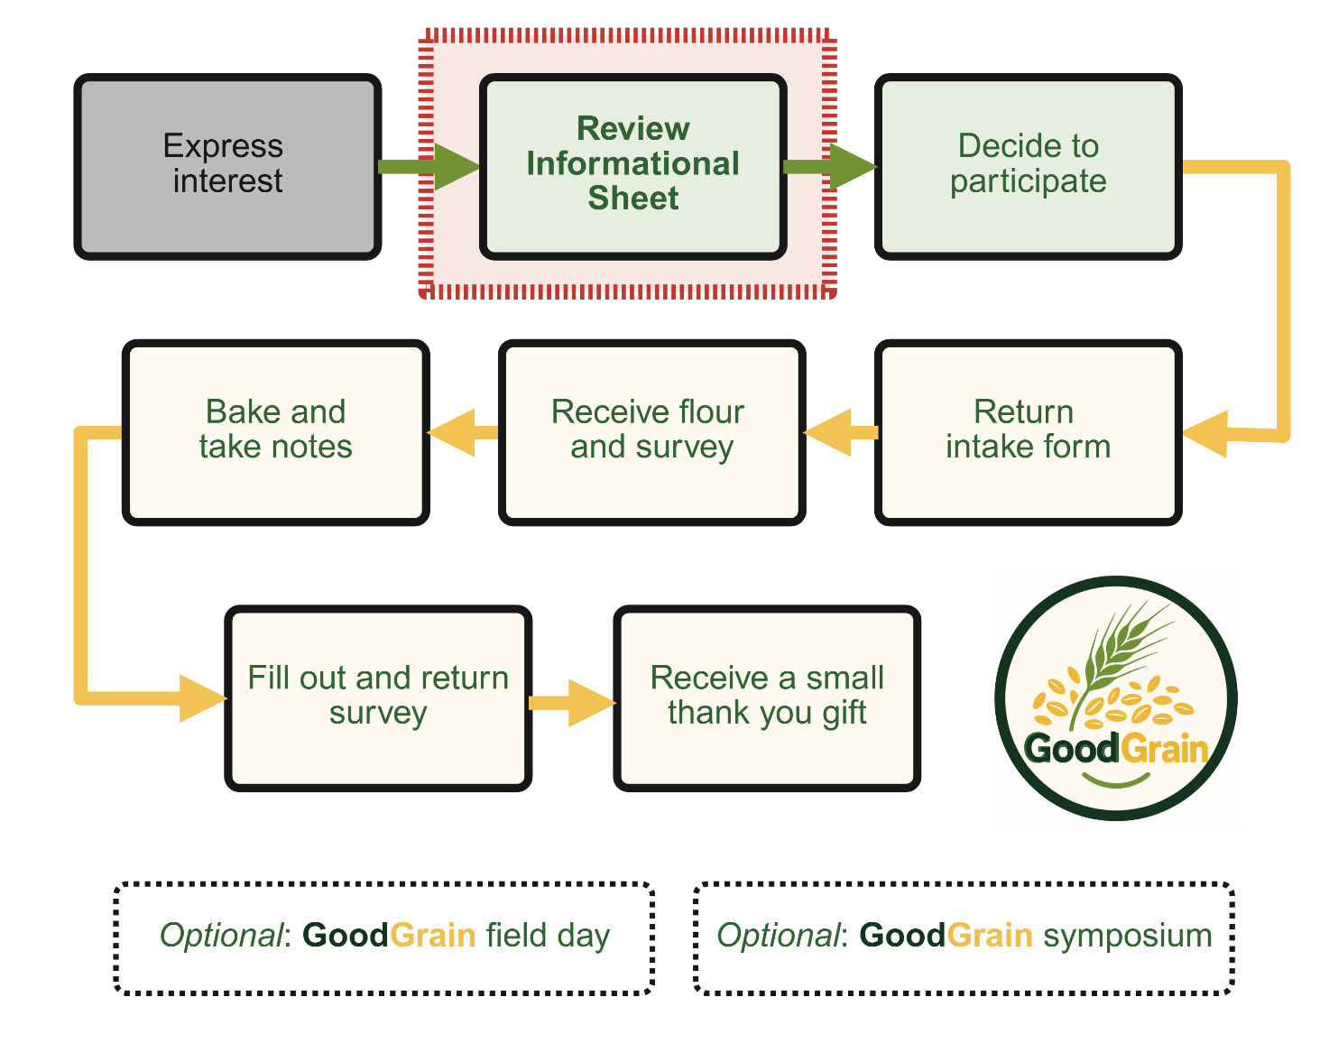
GoodGrain Home Baking Evaluation
For the Curious
GoodGrain Home Baking Evaluation

Slide 2
This presentation provides:
An overview of the GoodGrain project
What is expected of you as a citizen scientist in the Home Baking Evaluation
More in-depth information about the new perennial rye variety
The same information is also available in an informational sheet in English and Danish
GoodGrain Home Baking Evaluation

Slide 3
GoodGrain Home Baking Evaluation

Slide 4
What happens next?
Watch this Informational Video (in English) or read the Informational Sheet in English or Danish.
Afterwards, if you decide you would like to participate in the research, complete the intake form.
GoodGrain Home Baking Evaluation

Slide 5
Why GoodGrain?
Common bread crops such as wheat, oats, rye and barley are annual grains: they are sown, produce one grain harvest, and must then be sown again.
An alternative would be a perennial grain, which would continue to live after it is harvested.
A perennial grain producing two or three grain harvests from one sowing could save farmers work and tractor driving.
By remaining in the field for several years, a perennial grain could develop more roots, which could in turn be beneficial for the environment. More roots could sequester more carbon, they could feed the soil biology for more of the year, and they could help the crop use nutrients more efficiently, or be more resilient to drought.
There is more information about this later in the video.
A few perennial grain varieties have recently been developed, including a perennial rye that is being tested in Denmark.
GoodGrain Home Baking Evaluation

Slide 6
Why GoodGrain?
Field testing is currently evaluating how the new perennial rye grows in Denmark and how it affects the environment compared with annual rye.
GoodGrain builds on this field testing by looking specifically at the new perennial rye's grain characteristics.
One important characteristic is baking quality.
Other aspects being studied in GoodGrain include the nutritional quality of the grain, and the prevalence of a common fungus, ergot, which can be found in harvested grain.
GoodGrain Home Baking Evaluation

Slide 7
Why a home baking study?
The main goals of this home baking study are to:
Start to understand the best uses for this perennial rye for home bakers
Guide future research efforts
Understand how people feel about baking with perennial rye
GoodGrain Home Baking Evaluation

Slide 8
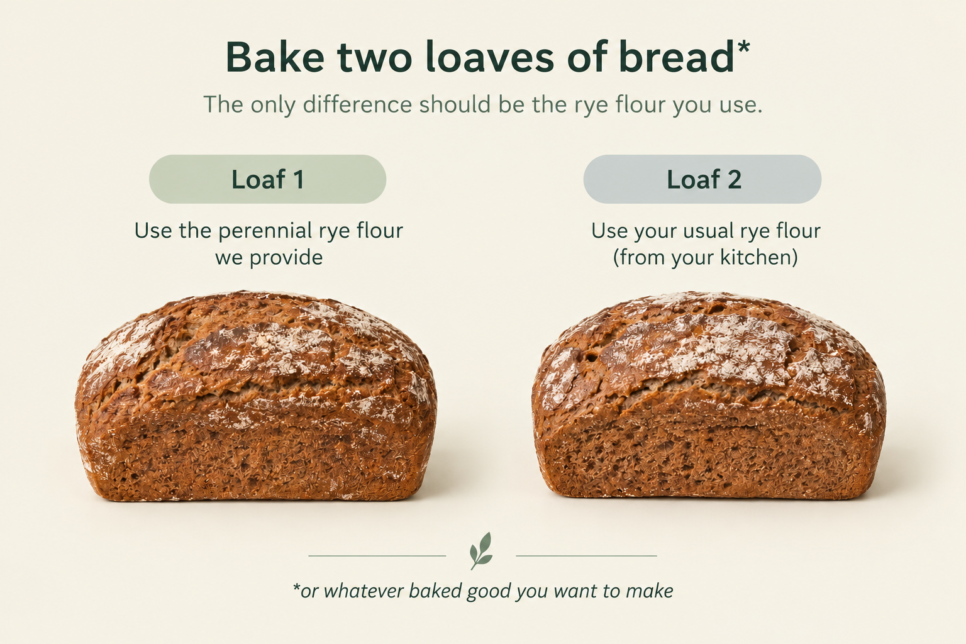
What is expected of me as a participant in the home baking study?
GoodGrain Home Baking Evaluation

Slide 9
What is expected of me as a participant in the home baking study?
You will receive 400 or 800 grams of perennial rye flour (depending on your baking needs).
You will need to purchase any additional ingredients needed for your baking.
You will bake two items, one using the perennial rye flour, one using your normal flour.
You will take notes during baking.
Complete a post-baking survey (which we estimate will take 15-30 minutes).
After submitting the post-baking survey, you will receive a small thank-you gift.
GoodGrain Home Baking Evaluation

Slide 10
Optional events
Summer 2027
Public event where you can see perennial rye growing in the field
Fall 2027
A public symposium to share information about perennial rye
Both are free and open to the public!
Attendance at the GoodGrain field event and symposium is optional and is not required for participation in the Home Baking Evaluation.
GoodGrain Home Baking Evaluation

Slide 11
Is it safe to eat?
Yes.
The grain used to make the flour you will receive was tested at an independent laboratory to ensure it is safe for human consumption.
The laboratory results are available (in Danish) the GoodGrain Lab Results PDF, which you can access through the intake survey and/or the Informational Sheet website.
GoodGrain Home Baking Evaluation

Slide 12
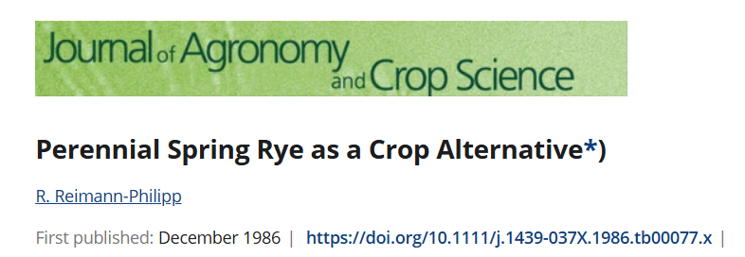
Is the perennial rye genetically modified?
No.
This variety was developed using traditional breeding methods.
Plants were crossed by hand, followed by selection based on their physical characteristics.
You can see a scientific publication from 1986 for more information:
GoodGrain Home Baking Evaluation

Slide 13
Is this grain organic?
No.
Aarhus University does not have organically certified land because of the costs and additional administrative complexity.
However, this grain was grown without the use of pesticides.
GoodGrain Home Baking Evaluation

Slide 14
Can I buy this flour?
No.
Flour from this perennial rye variety is not currently available commercially.
The project is laying the groundwork for a potential commercial release.
Your help with the home baking evaluation is appreciated!
GoodGrain Home Baking Evaluation

Slide 15
For the curious:
GoodGrain Home Baking Evaluation

Slide 16
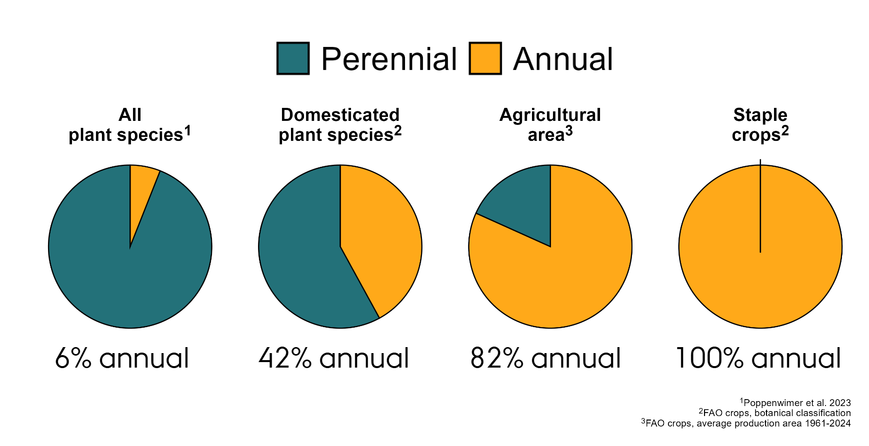

Slide 21
Why might perennial crops be useful?
It is not yet clear whether annual plants are inherently superior for food production or whether humans simply happened to domesticate them.
Having more perennials integrated into agricultural land would offer environmental benefits.
Perennials can help put carbon into the soil.
They provide soil cover year-round, protecting it from wind and rain.
They can use resources, such as water and nitrogen, more efficiently.
Living roots can help promote a healthier and more active soil biology
Creating perennial versions of staple crops, such as rye, is one way to integrate more perennials into agriculture.
GoodGrain Home Baking Evaluation

Slide 22
Perennial grains
There have been efforts to breed perennial wheat since the 1930s.
There has been success in creating wheat plants that regrow after harvest.
Multiple harvests is still difficult, and grain yields are low.
Intermediate wheatgrass has been used as a forage, and is being bred for grain production.
The grain has been registered with the name Kernza®.
As of 2026, Kernza® is not approved for human consumption in the European Union.
Grain yields are low.
GoodGrain Home Baking Evaluation

Slide 23
The history of this perennial rye
At the University of Hohenheim in Germany, Dr. Reimann-Philips and his team crossed annual rye with an old perennial rye ancestor in the 1960s.
They tested the resulting plants and made further selections.
The resulting crop was perennial and, in the 1990s, was submitted for consideration as a variety in Germany.
GoodGrain Home Baking Evaluation

Slide 24
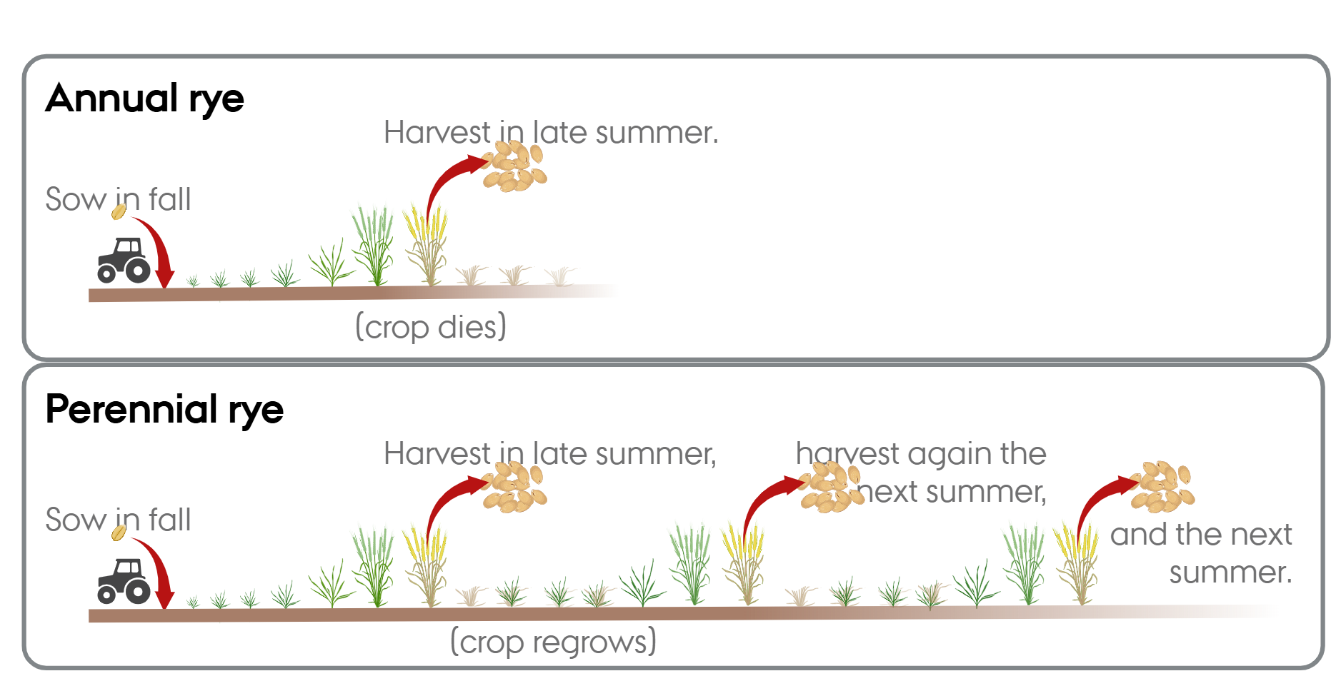
GoodGrain Home Baking Evaluation

Slide 25
How long will the crop produce grain?
This has not yet been tested extensively.
The perennial rye appears to reliably produce grain for at least two years.
After that, weeds and diseases may become problems.
More research is needed to determine the optimal way to manage the crop.
GoodGrain Home Baking Evaluation

Slide 26
What happened to the crop?
The German government rejected the application, and the crop was never released as a variety.
The breeders maintained some plots as a passion project.
Some material was later released as a wildlife forage crop.
The perennial rye received little attention for about thirty years.
In 2023, Dr. Thomas Miedaner shared seeds with researchers at Aarhus University.
GoodGrain Home Baking Evaluation

Slide 27
Why are we interested now?
Researchers at Aarhus University think perennial rye has a lot of potential in Denmark.
In 2025, the perennial rye was tested side-by-side with a high-yielding annual rye.
It produced about half the grain yield (3-4 tons per hectare) of the modern annual rye (8-9 tons per hectare).
The result was especially promising given that the perennial rye was crossed with varieties from the 1960s.
GoodGrain is part of the effort to develop and understand this variety.
GoodGrain Home Baking Evaluation

Slide 28
Thank you!
Thank you for considering participation in the GoodGrain Home Baking Evaluation.
Your baking experience will help us understand how this perennial rye performs in home kitchens and how people feel about eating a perennial grain.
GoodGrain Home Baking Evaluation

Slide 29
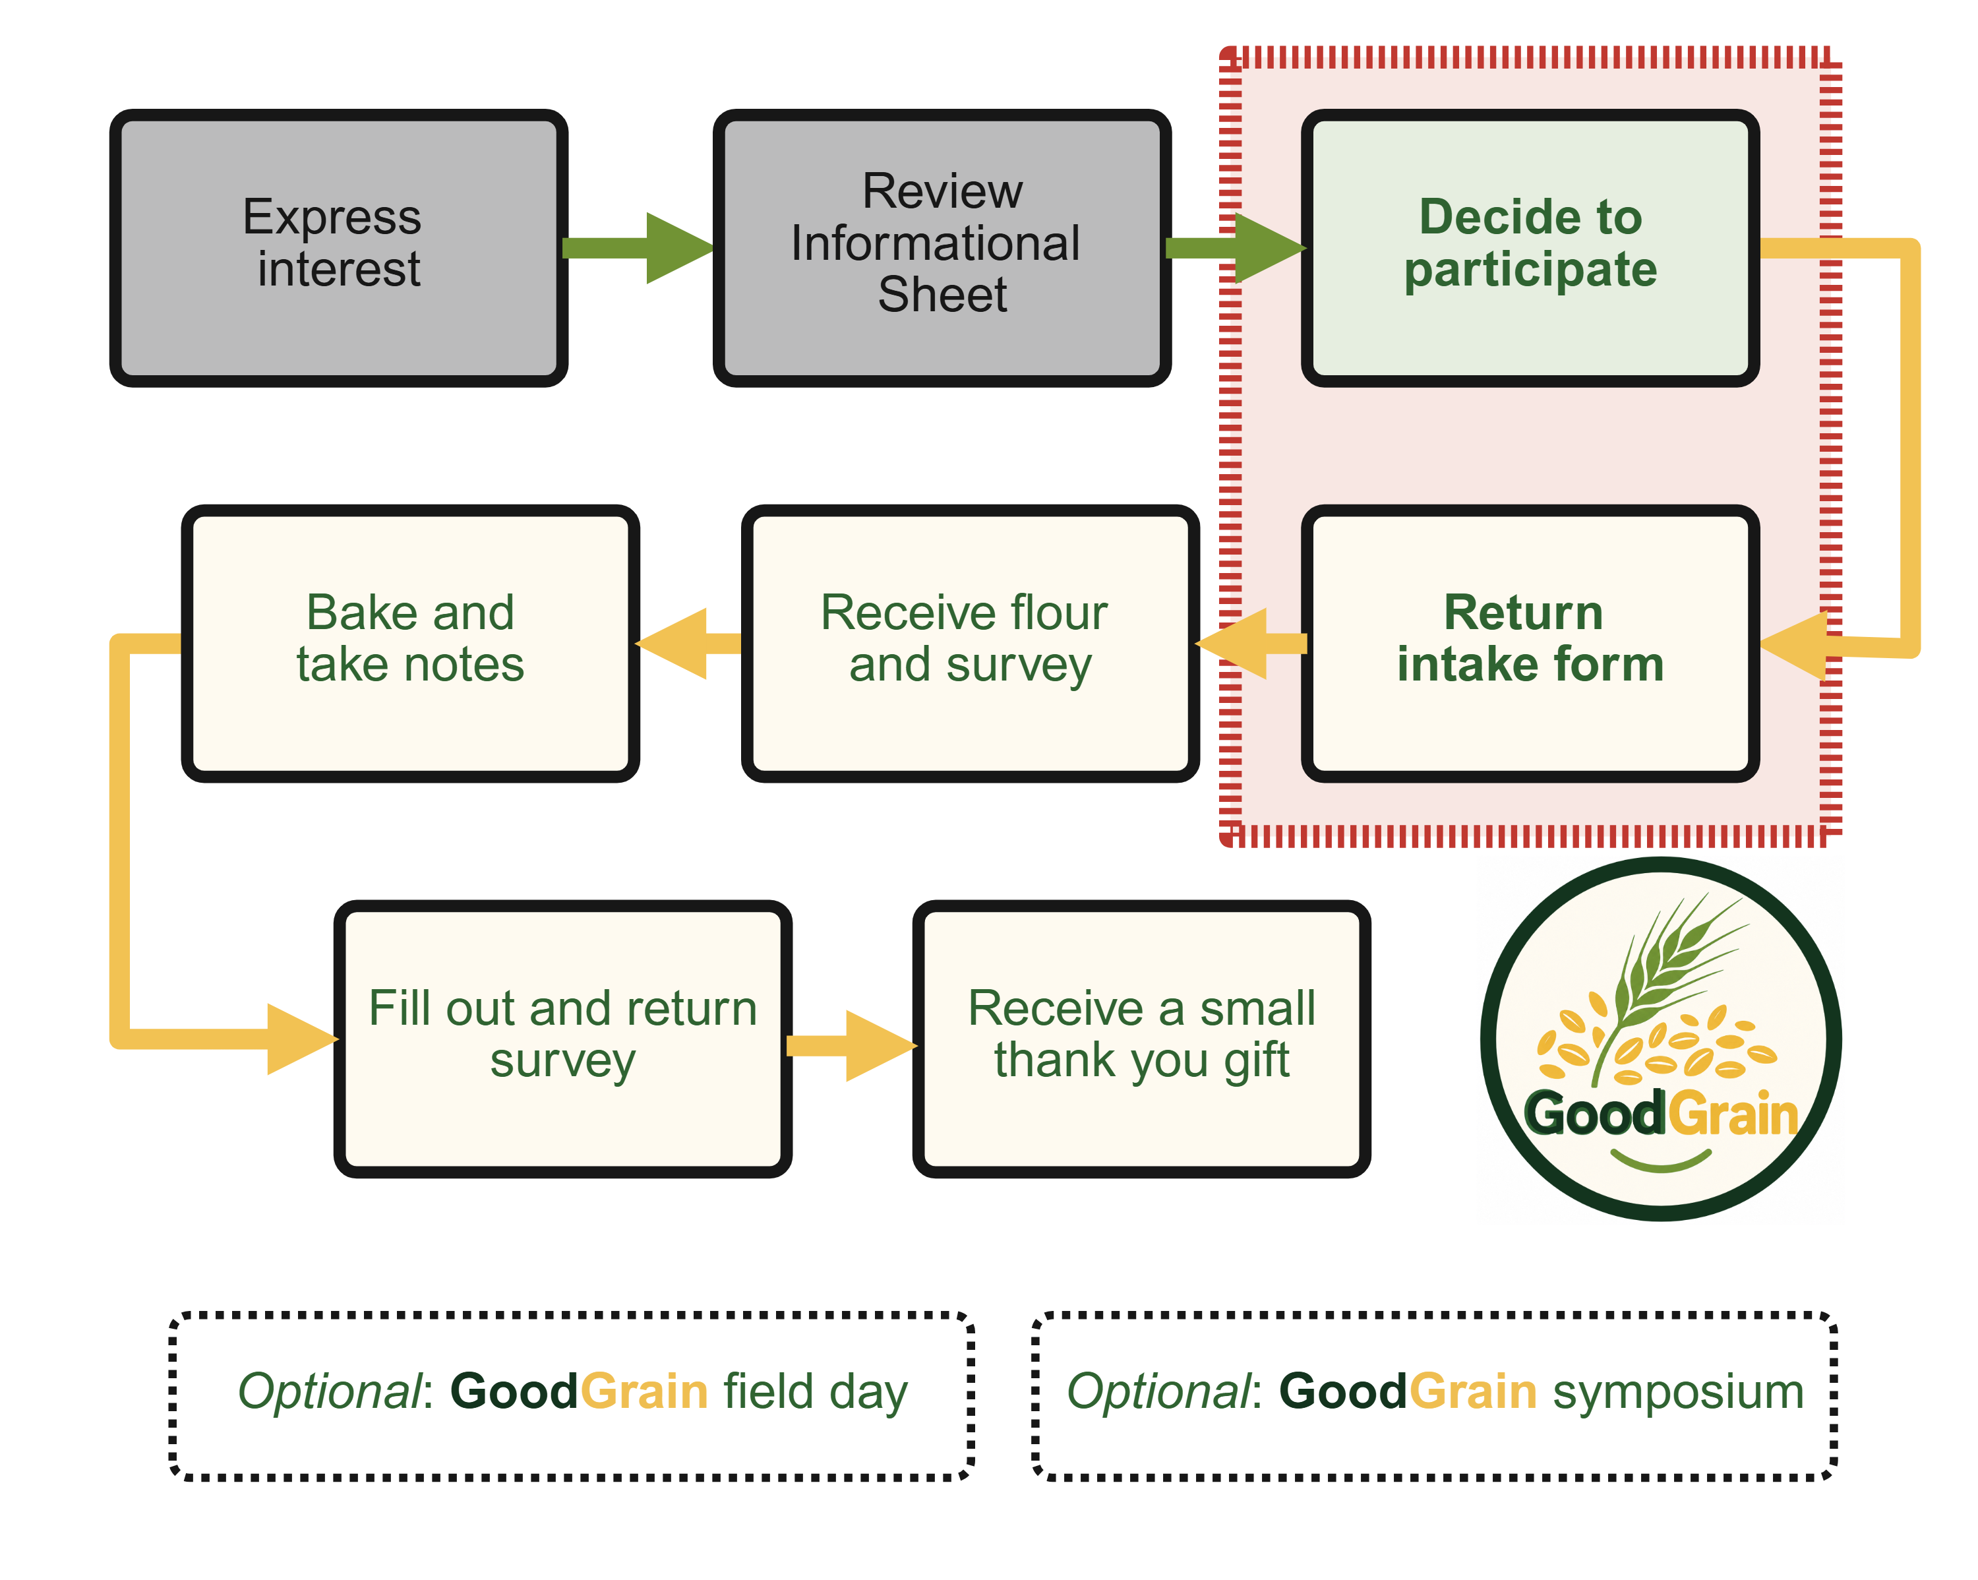
GoodGrain Home Baking Evaluation

Slide 30
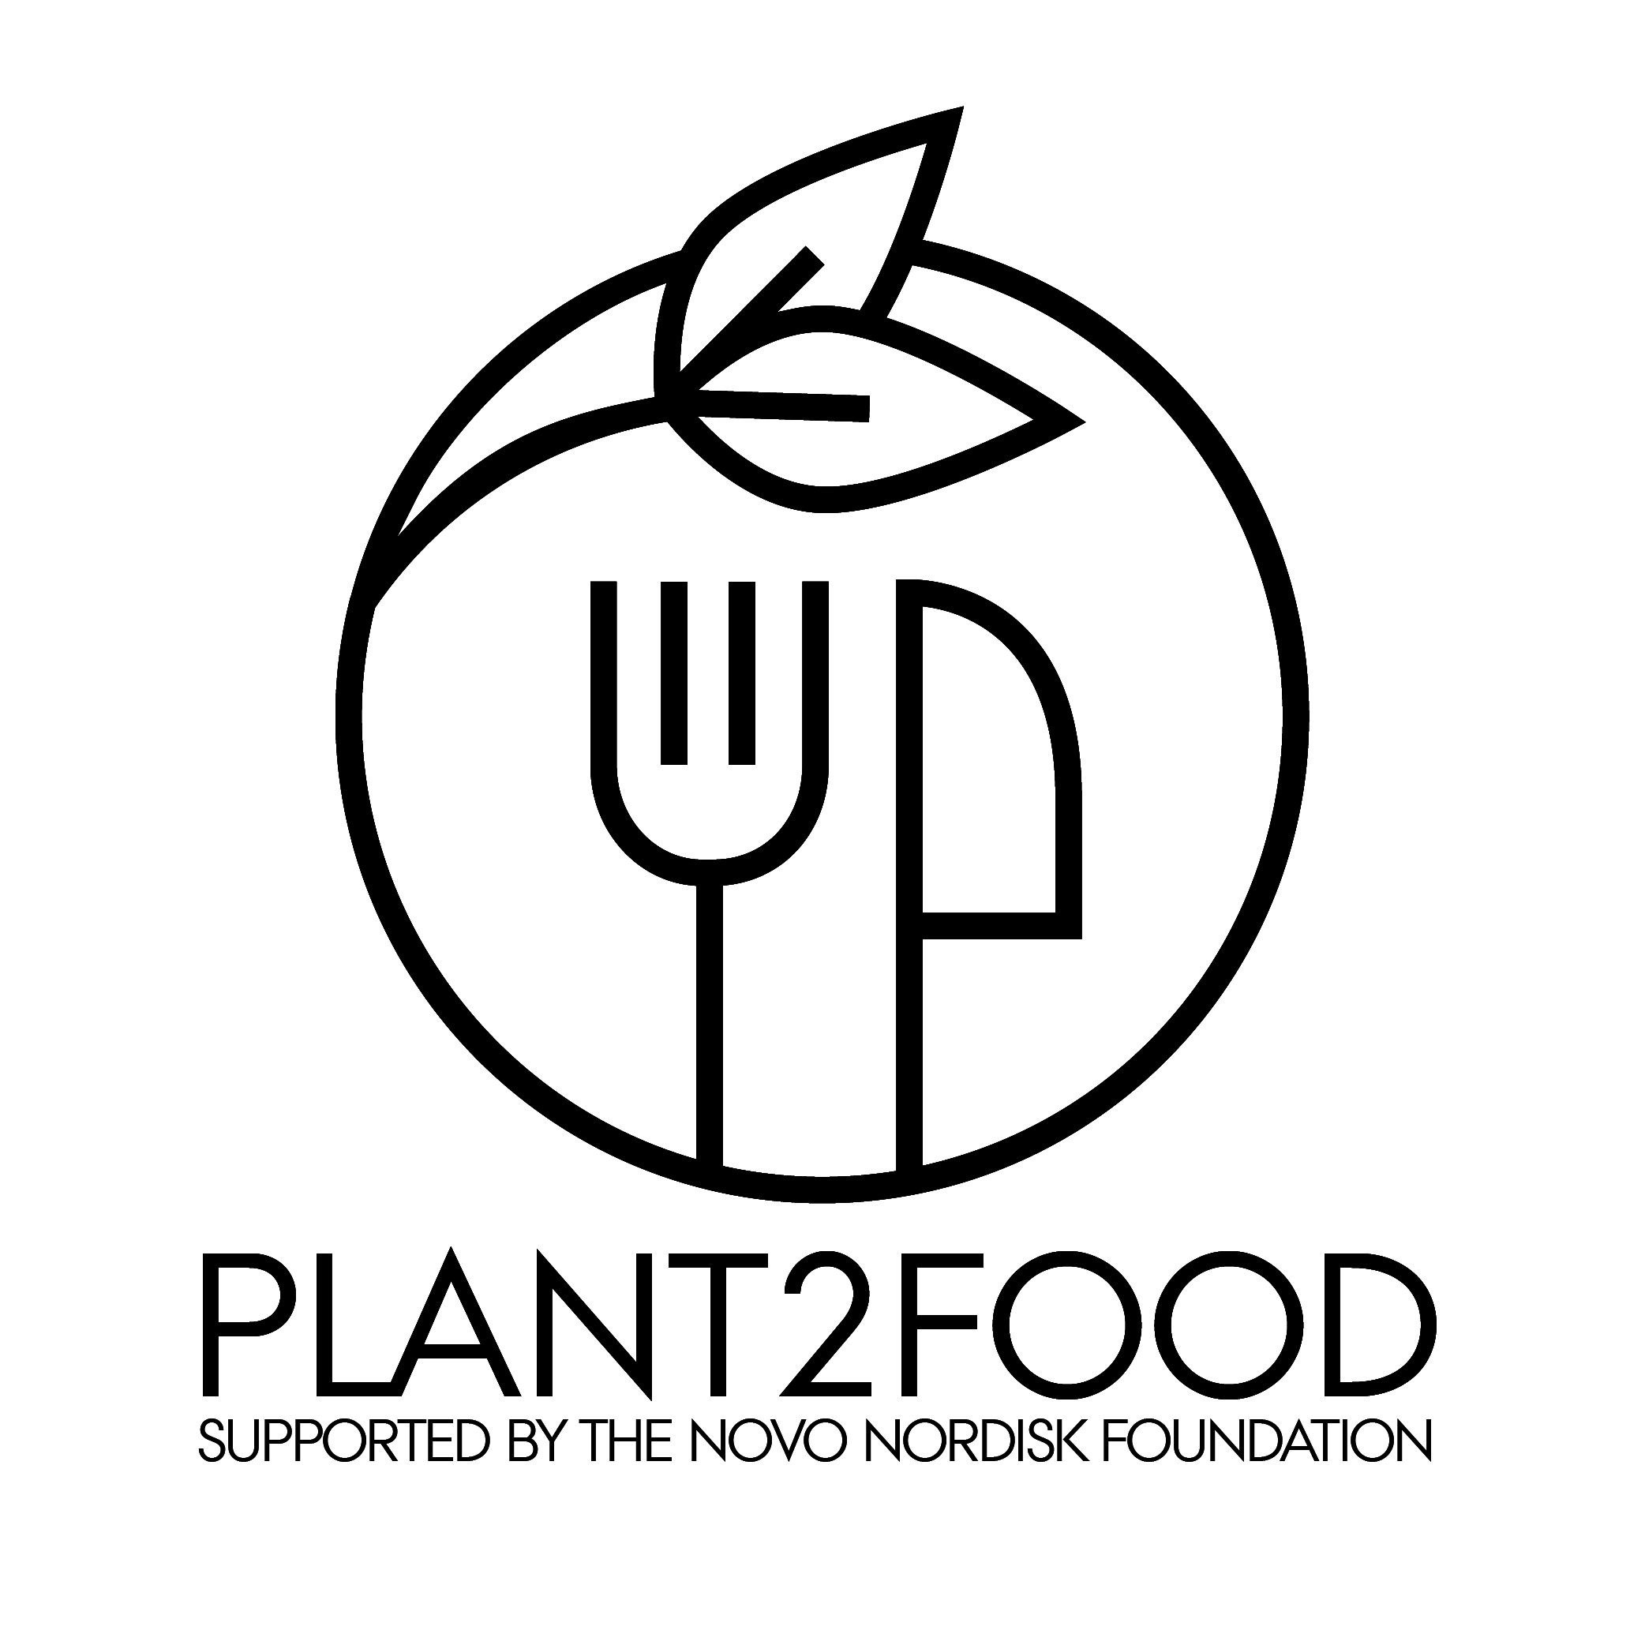



Funding and project partners
This citizen science project is part of an NNF Plant2Food research project (Grant #NNF22SA0081019).
Aarhus University: Department of Agroecology and Department of Food Science
Wageningen University and Research, Netherlands
Meyers, a Danish food enterprise
More information: projects.au.dk/plant2food/funded-projects/goodgrain
GoodGrain Home Baking Evaluation

